Slide 1


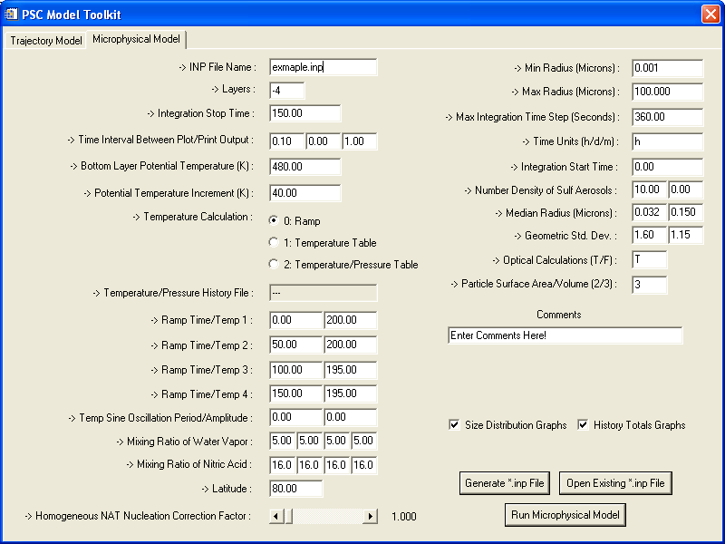
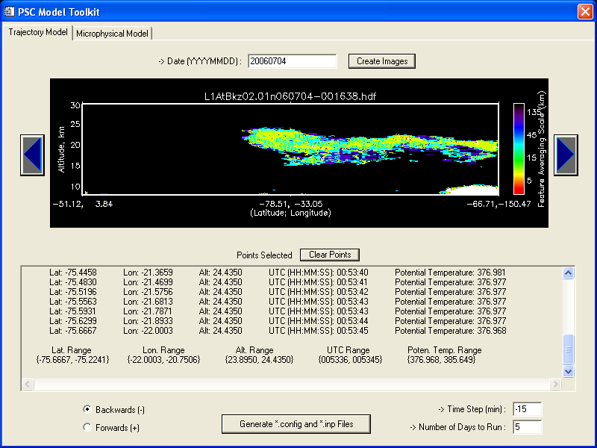
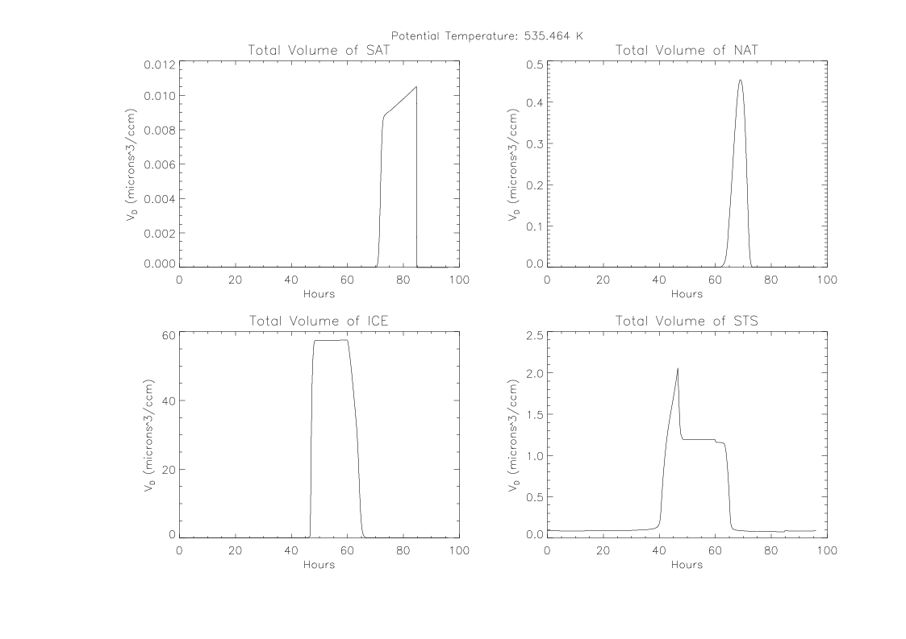
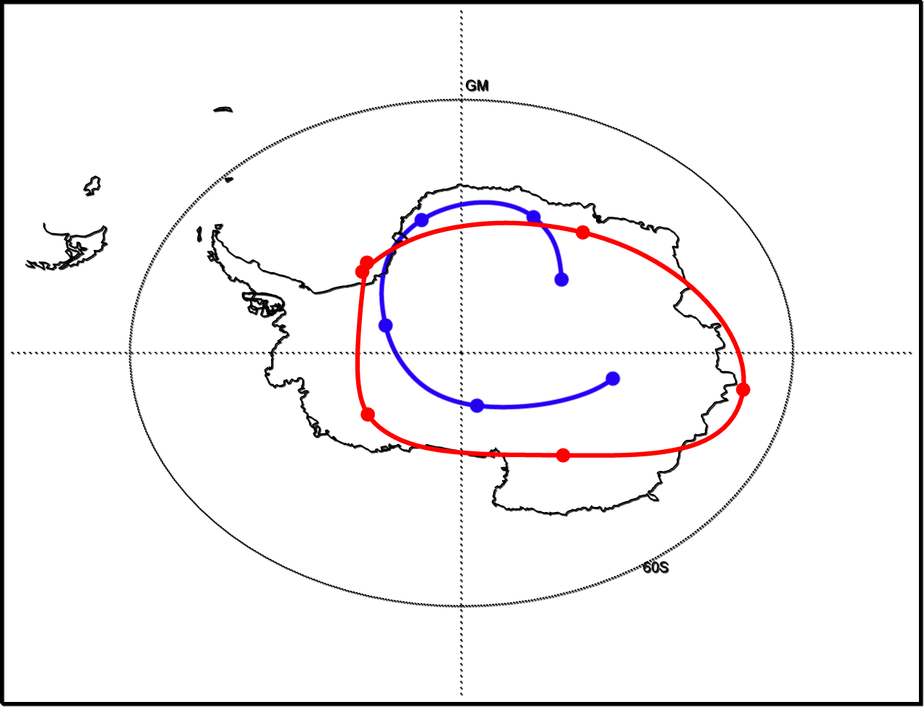
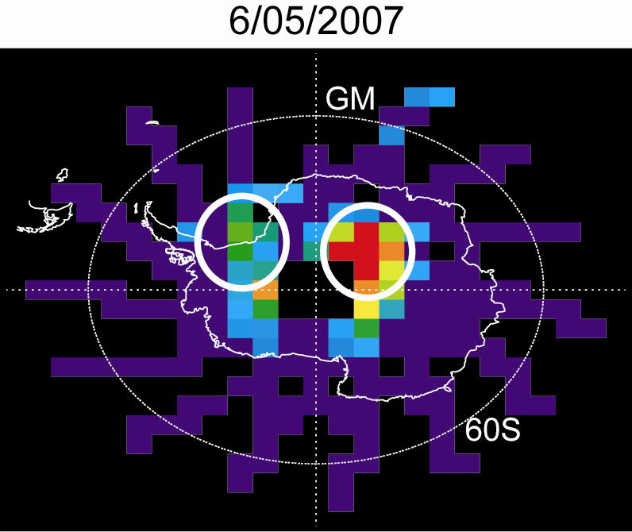
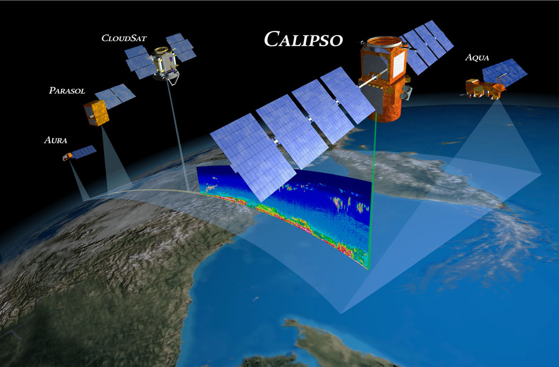
Analysis Tools for Polar Stratospheric Cloud Studies Using CALIPSO Data
John C. Wherry¹, Michael C. Pitts², Larry W. Thomason²
¹Austin Peay State University, Clarksville, TN, USA
²NASA Langley Research Center, Hampton, VA, USA
Abstract
Tools
Studying the formation and evolution of polar stratospheric clouds (PSCs) is very important to understanding different aspects of Earth’s global climate change. Using CALIPSO (Cloud-Aerosol Lidar and Infrared Pathfinder Satellite Observations) data, we can better understand how these clouds affect the Earth’s climate. PSCs, which form over the polar regions during the winter at altitudes between about 15 to 30 km, play an important role in the formation of the ozone hole. The CALIPSO data is providing the first comprehensive set of PSC observations from space. To better understand how these clouds form and evolve with time, we currently combine the CALIPSO observations with two computer models. The first, a microphysical cloud model, simulates how the clouds form and behave in the atmosphere. The second, an atmospheric trajectory model, simulates the transport of these clouds in the atmosphere. Analysis tools to help LaRC scientists explore the formation of PSCs using these models are needed to further the research on PSCs. The focus of this project is to design and build analysis tools that greatly increase the efficiency at which the scientists can run the models and compare the outputs to the observed CALIPSO data. To get a better understanding of the role of PSCs in global climate, efficient software is needed so that LaRC scientists can focus more on exploring the data produced from the models instead of spending time running the models. The refactoring of older code into more streamlined, agile code has been a major part of this project in order to construct a more efficient system.
IDL
The computer language that these analysis tools are written in is IDL. This language provides us with a great deal of flexibility in the work being done. In figure 1, you can see the plotting area in the middle of the GUI (graphical user interface). It is very easy in IDL to calculate large volumes of data very quickly and visualize them. This is great in that it allows us to display images and results quickly without having to worry about all the in betweens that other languages have when dealing with displaying graphics. IDL creates a nice environment that is easy to learn and easy to use.
Fortran
All of the models are written in the Fortran. The refactoring of the old Fortran to fit the new GUI IDL interface proved to be more difficult than anticipated. The Fortran code, being compiler specific in most cases, was hard to debug and refactor because it was highly dependant on the compiler and not the language itself. So a learning of both Fortran and Fortran on a Compaq compiler had to be learned in order to refactor the code correctly.
Microphysical Model GUI
Trajectory Model GUI
Fig. 2
Fig. 3
Introduction
When it comes to refactoring an existing software system, many problems arise during the development of the new software system. Firstly, the computer scientist/software engineer has to have a thorough understanding of what the current system is doing. This makes for a steep learning curve where the programmer spends a lot of time learning the system and not working on it. Secondly, the refactored code has to be of more benefit than it was before it was refactored. Being able to correctly do this is a challenge. Refactoring code consists of a few key concepts:
1) System has been improved upon once the refactor is finished.
2) Code is more modular and agile.
3) The inner workings still produce the same output but in a cleaner, faster way.
By keeping these concepts in mind, software systems can be completely reworked in a fashion that produces a better system once completed.
Fig. 5
Fig. 6
Results: Trajectory Model
The trajectory model provides us with an easy way to track the movement (trajectory) of air parcels in Earth’s atmosphere. We select points from the CALIPSO data using the GUI tool (Fig. 3) and run those points through the trajectory model. This model can simulate both forward and backward trajectories, depending on the need. Fig. 5 shows an example air parcel trajectories for two PSCs observed by CALIPSO. The trajectory model is useful in PSC studies because it provides information on the source and time history of air parcels that ultimately become clouds. The GUI tool records temperature and other parameters at each time step along the trajectory path. The trajectory outputs can then be input into the microphysical model to simulate cloud formation along the trajectory. Process studies combining the CALIPSO data with both the trajectory and microphysical models will provide insight to PSC formation mechanisms. The analysis tool (Fig. 3) provides a highly effective interface for the trajectory model.
Results: Microphysical Model
The microphysical model that we use is a model that simulates how clouds form in the atmosphere. This model provides us with insight to the detailed processes of cloud formation mechanisms. If we can correctly simulate the formation of these clouds, we can have a better understanding of the system as a whole. Since PSCs play a large role in polar ozone depletion, understanding how they form is very important. The analysis tool that interacts with the microphysical model allows us to change the inputs to the model and run test cases very quickly. This gives us a huge amount of data to work with in a very short amount of time that would have taken much longer to accumulate before the tool was developed. Since the model helps us understand how PSCs form, being able to “tweak” the model inputs is a necessity. This allows us to easily change model input parameters to better simulate the observed data that CALIPSO provides. Process studies combining the microphysical model with CALIPSO data will ultimately lead to an improved understanding of the role of PSCs in the ozone hole.
Conclusion
This project has produced valuable analysis tools for the LaRC scientists. These tools provide an effective and efficient means to perform PSC process studies combining CALIPSO data with microphysical and trajectory models. By combing older systems and refactoring them into a newer GUI driven system, utilization of the models has been streamlined and greatly simplified. The LaRC scientists can now easily use these new analysis tools in their everyday analysis of PSC data without having the overhead of running cumbersome code and separate data plotting routines. The new software system is much more time efficient, allowing scientists more time to work on more important aspects of their research. Efficient software that simplifies the research process can be beneficial to the scientific community as a whole. New areas can be explored because researchers are no longer hindered by the limitations of the machine they are on or the software they are using. NASA’s own mission statement “To research, develop, verify, and transfer advanced aeronautics and space technologies “ can implemented at the very basic level here, starting with the development of new software to deal with the massive amount of research that NASA researchers undertake. Newer and better software systems provide almost limitless possibilities for research.
CALIPSO and the “A-Train” In Their Earth Orbit.
Fig. 1

